Slide 1
Covid detection BASED ON x-Ray
KUNNATH RADHESH (URK17CS028)
SANDEEP (URK17CS023)
SARA SUMANTH (URK17CS037)
KUDUMALA ANIL KUMAR REDDY (URK17CS114)

Slide 2
Problem statement
Novel coronavirus or SARS-COV-2 strain is responsible for COVID-19 and it has already shown the deadly nature of respiratory disease by threatening the health of millions of lives across the globe. Blood test usually takes a lot of time and people need to wait for so long to get the report. The possibility to use widespread and simple chest X-ray imaging for early screening of COVID-19 patients is attracting much interest from both the clinical and the AI community. Using Deep learning models to produce faster and better results in a short interval of time

Slide 3
Objective
COVID-19 is deadly and is very infectious type of disease in the recent time and it has shown the deadly nature of respiratory disease by effecting millions of lives across the globe . The Objective of this project is to detect the COVID-19 effected patients from Chest X-Ray images using CNN(Convolution Neural Network).Using Traditional RT-PCR methodology, it not only takes a lot of time but the results obtained may contain more false positive or false negative results. Therefore,Covid-19 screening can be adopted using X-Ray. It is a layered architecture, The sequential model will have conv2d layers followed by maxpooling, dropout, flattening, activation function as relu and optimiser as Adam. Finally it classifies whether it is covid positive or negative.

Slide 4
Existing works
Many works have been carried out during recent times
1. Deep learning techniques (Resnet50 and VGG16)
An accuracy of 89.2% and an AUC of 0.95 is obtained with the dataset consisting of 102 both positive COVID-19 cases and pneumonia cases
2. Transfer learning-based model
An accuracy, sensitivity, and specificity of 96.78%, 98.66%, and 96.46% respectively is obtained. Two types of datasets are used:
a) 224 images of COVID-19 disease, 700 images of common bacterial pneumonia and 504 images of normal patients
b) 224 images of COVID-19 disease, 714 images of bacterial pneumonia and 504 images of normal patients

Slide 5
3. ResNet50, InceptionV3 and Inception-ResNetV2
An accuracy of 98% obtained with ResNet50, 97% accuracy with InceptionV3, and Inception-ResNetV2 gives 87% accuracy. 50 images of each COVID-19 positive cases [18] and normal cases
4. 3-D CNN model (Residual networks)
528/90 (Training and validation data: COVID-19 = 189, Influenza-A viral pneumonia = 194, and normal= 145) (Testing data: COVID-19 = 30, Influenza-A viral pneumonia= 30, and normal= 30). AUC is 0.996, 98.2% sensitivity and 92.2% specificity.
5. Joint Classification and Segmentation (JCS)
large scale COVID-19 dataset with 144,167 images of 400 COVID-19 patients and 350 Non-COVID cases. JCS system provided an average sensitivity of 95% and 93% specificity for the classification, and dice score of 78.3% on the segmentation test set

Slide 6
6. Different CNN models namely, AlexNet, VGG16, VGG19, GoogleNet, and ResNet50
349 COVID positive and 397 Non-COVID CT scan images .on comparision ResNet50 is the best performing model and achieved 82.91% testing accuracy.
7. 2D and 3D deep learning models
Datasets of Chinese control and infected patients. Creation of heat map or a 3D volume display of COVID-19 cases along-with Corona score.
The sensitivity of 98.2%, the specificity of 92.2%, and AUC of 0.996, achieved for binary classification of the COVID vs Non-COVID dataset.
8. Random forest (RF) model
76 chest CT images of COVID-19 positive cases. For the COVID-19 severity detection, the accuracy achieved is 87.5%, AUC is 0.91, and True positive rate (TP) is 93.3%.

Slide 7
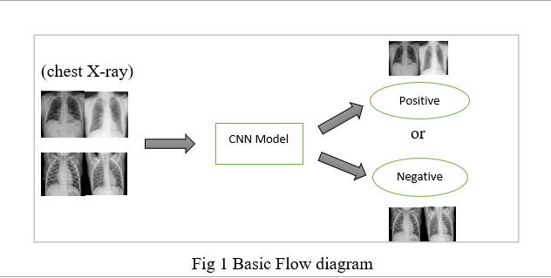
Methodology
Here the Input Image is either COVID positive Chest X-Ray or Normal Chest X-Ray image. After removing the unnecessary data from the dataset, it is passed to the CNN model for detection. The basic Flow diagram is shown below for better understanding

Slide 8
CNn architecture
-> It is a layered architecture. The sequential model will have a Conv2d layer with 32 number of filters in the beginning with the kernel size of 3 X 3 and relu as the activation function. As this is first Layer the input size specified is 224 X 224 X 3.
-> In the second layer ,the filters are increased to 64 and the conv2d layers are stacked on top of each other with same filter size of 3 X 3 because this can reduce the overall weight parameters instead of using a single layer and it is followed by Maxpooling2d layer with pool size of 2 X 2 and dropout layer which is used to avoid overfitting. Now the above mentioned layers are repeated again and stacked upon each other so that inner layers can easily detect the larger portion of the image. Once the above layers are created ,we need to flatten the layer. The below given figure gives the clear understanding of our CNN model.

Slide 9
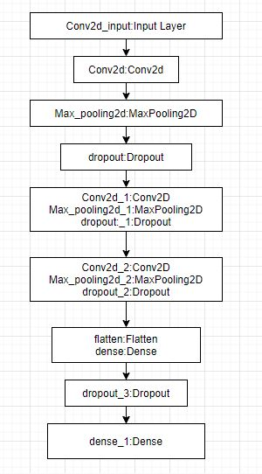
CNN architecture
In the output layer we have a single neuron because this is a binary classification so we use sigmoid as activation function . Finally compile the model with binary cross entropy loss, optimizer used is “Adam”, with the metrics as Accuracy. It consists of more than 55 lakh parameters in total.

Slide 10
In the training part, we used Keras Image data generator library to make the data ready for the Model.
Augmentation is performed on the Original image such as rescaling the image(Normalization), shear augmentation, zoom augmentation and horizontal flip. similarly in the testing part we perform normalization and pass it to the image data generator library.
In the train data generator, target size of 224 X 224 is specified because the model input should be similar to the target size that is being feed in to the model, with the batch size of 32 and mode of class is binary.it is then passed into the model and in the similar way validation data generator needs to be specified with same target size, batch size and mode of class.
The final part is to train the model by passing train generator, steps per epoch, no of epochs ,validation generator. The model performed better as the no of epochs increases and highest accuracy of 98.6% is recorded

Slide 11
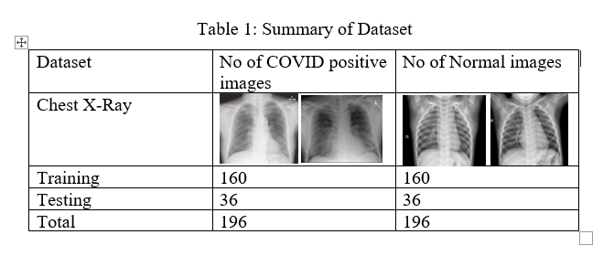
Performance analysis
Dataset

Slide 12
PLATFORM AND TECHNOLOGY USED
Link to Covid chest X-ray images
https://github.com/ieee8023/covid-chestxray-dataset
Link to Normal Chest X-Ray images
https://www.kaggle.com/paultimothymooney/chest-xray-pneumonia
This experiment is carried out both in local machine as well as in Google Colab. Collecting all the data from the open source repositories and removing the unwanted data is carried out in Jupyter Notebook(local machine) and for training the model, Google Colab with runtime environment as GPU is used for producing faster results. A total of 20 minutes is taken to complete the training of this model.

Slide 13
->Experiment Analysis
-In order to check the performance of the model we have carried out few analysis of various datasets which are different from the other with respect to normal chest X-Ray images. In the first Dataset consisting 224 images of both the classes are taken for training dataset and 60 images for validation .The accuracy obtained for Training dataset is 96 and validation dataset is 98.After a lot of understanding ,we try to increase the size of the dataset.
-In the second part of Analysis we have done some augmentation and increased the dataset size. A total of 320 images are taken into consideration for Training and 72 images for Testing. The reason behind taken in equal ratio is to make our model generalized without overfitting.

Slide 14
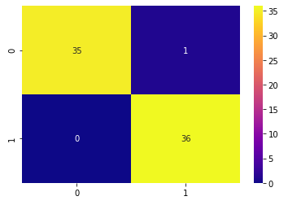
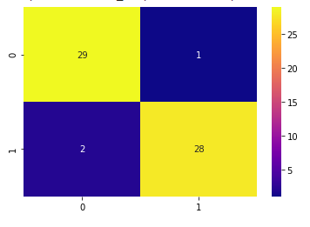
Using the Dataset A and B the performance analysis is here, The model has predicted 35 chest X-Ray images as covid positive out of 36, and similarly It has predicted 36 Chest X-Ray images as normal out of 36.

Slide 15
Challenges faced
When working initially in the local machine(Anaconda- Jupyter Notebook) ,few modules were missing even after downloading all packages .Later switching to Google Colab has helped to resolve this issue
Datasets related to COVID-19 positive chest X-Rays are not available properly in the public repositories. After Exploring , a Public repository is found consisting of all the chest X-Ray images. So removing all the unnecessary data and collecting Chest X-Ray images of only positive and negative cases are taken.
Working on a pre trained model has caused the model to overfit because the data present in the public repositories are very few and lot of layers need to be fine tuned. so Using CNN, resulted in a high accuracy for this model.

Slide 16
Conclusion
The proposed model detect COVID-19 from chest X-Ray using CNN. Dataset consisting of Chest X-Ray images are taken as input and passed to the CNN model. Before passing the data, Augmentation is performed on the training dataset. The Convolutional Neural Network model consisting of multiple layers such as conv2d,maxpooling,dropout etc. As we go deeper into the network, receptive field increases and inner layers can capture larger portion of the complex image. The accuracy obtained for the Validation data is 98.6%
Future work will involve collection of more Chest X-Ray images from early stage ,improving the accuracy by fine tuning all the layers in the pretrained model so that the weights of the pre trained model match with the given dataset and designing a end to end software model.

Slide 17
Thank you

